Slide 1
Ddelivery Time Historic Data
“Case study”
Abdulaziz Almalki
aalmalky88@gmail.com

Slide 2
Introduction
This project represents case study of analyzing historical Delivery Time Data.

Slide 3
Data
Historical data for Orders Delivery Times, including the Rating and the age of Captain, the geographical location of both restaurant and delivery location .

Slide 4
Objectives:
EDA which exploring the data examining and understanding the characteristics of your dataset
Cleaning the data and make it more ready for the analysis and visualization
visualizing the data for gaining insights, identifying patterns, and communicating findings in a clear and effective manner

Slide 5




Tools:

Slide 6
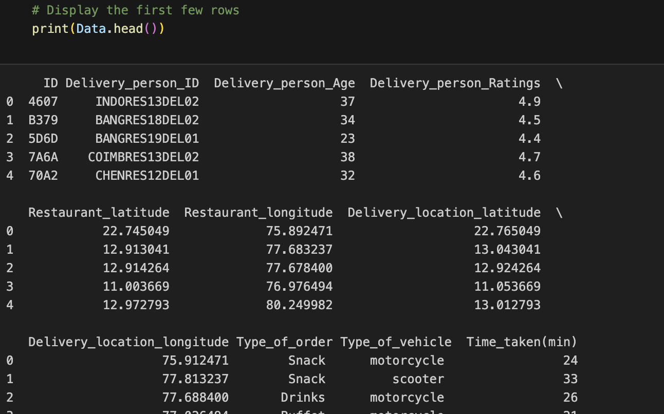
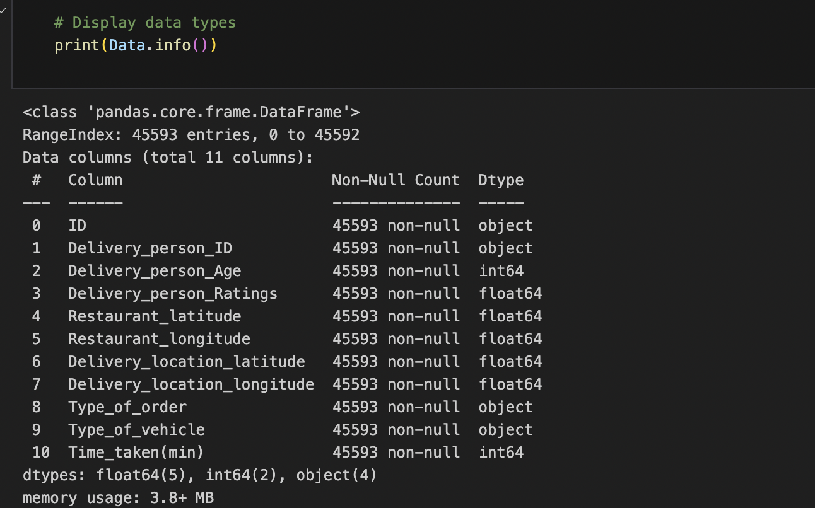
EDA
Basic Information about the Dataset:
few rows of the dataset to get an overview.
the data types of each column.
missing values.
Summary of the dataset

Slide 7
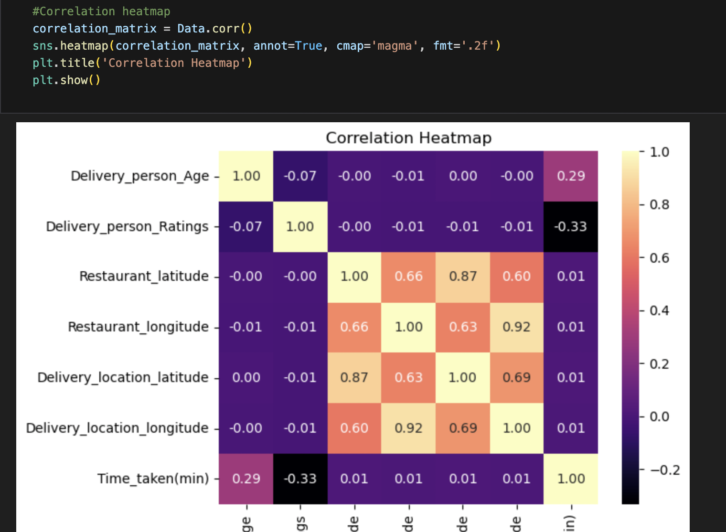
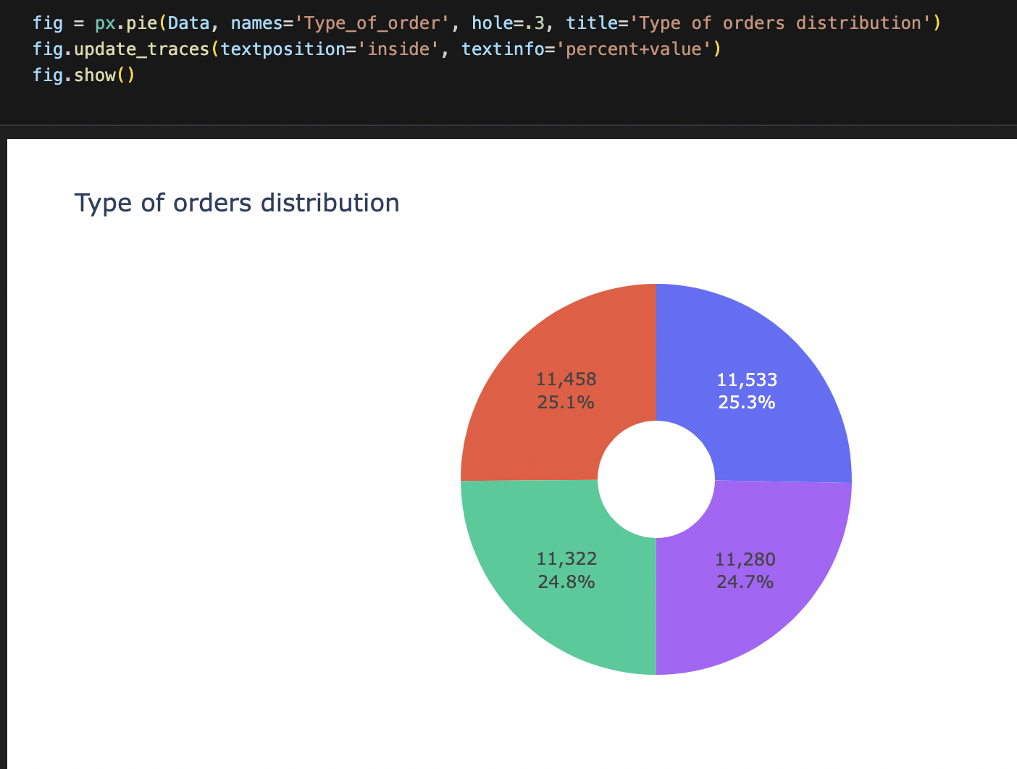
EDA visualization
Histogram.
Correlation Heatmap.
Boxplot to identify outliers.

Slide 8
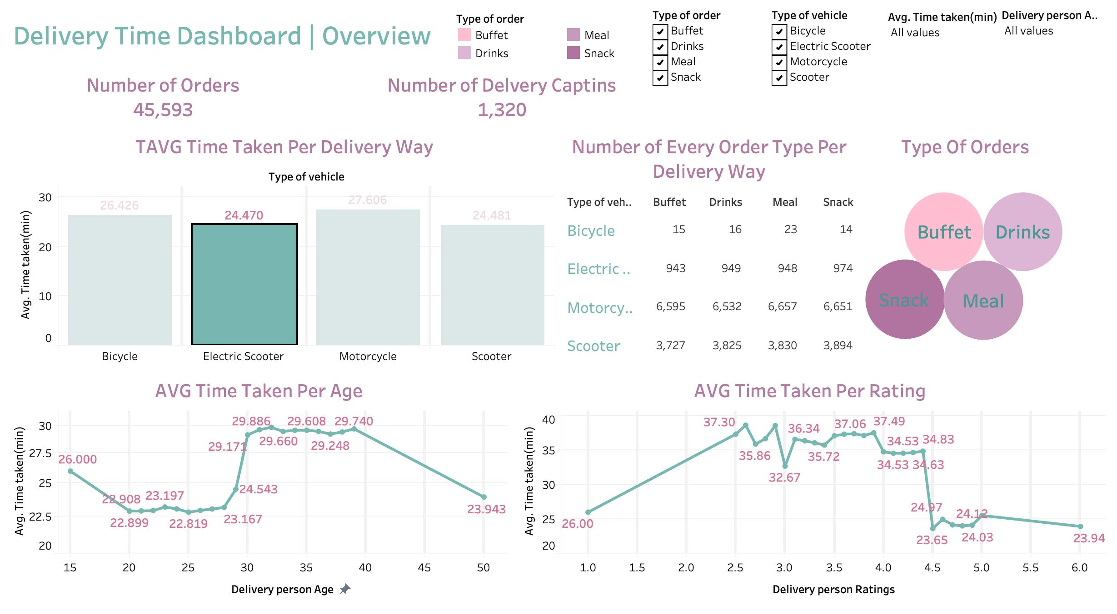
Creating the Dashboard Using Tableau
Access the live Dashboard By Clicking Here

Slide 9
Thanks for your attention

